Slide 1
IT Architects Credit Card Fraud Detection
Team 1: Arth Patel, Jay Patel, Tyler Helmrich, Xavier Jackson, Zenil Moradia

Slide 2
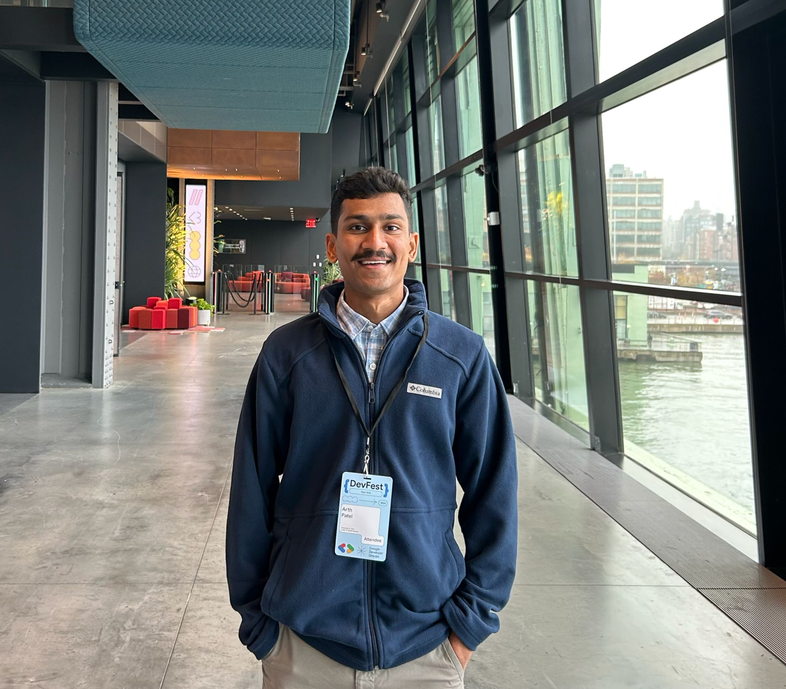
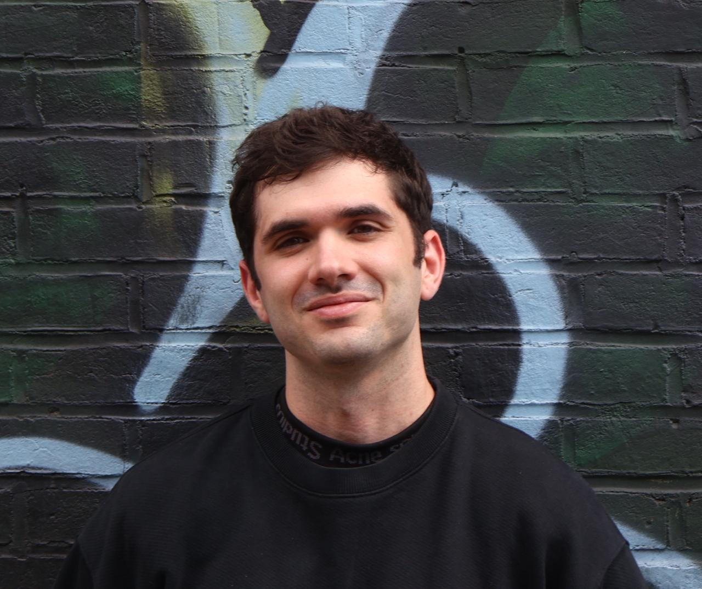
Team Members
Mr Arth Patel
Role : Front-End Developer
Mr Tyler Helmirch
Role: Scrum Master

Slide 3

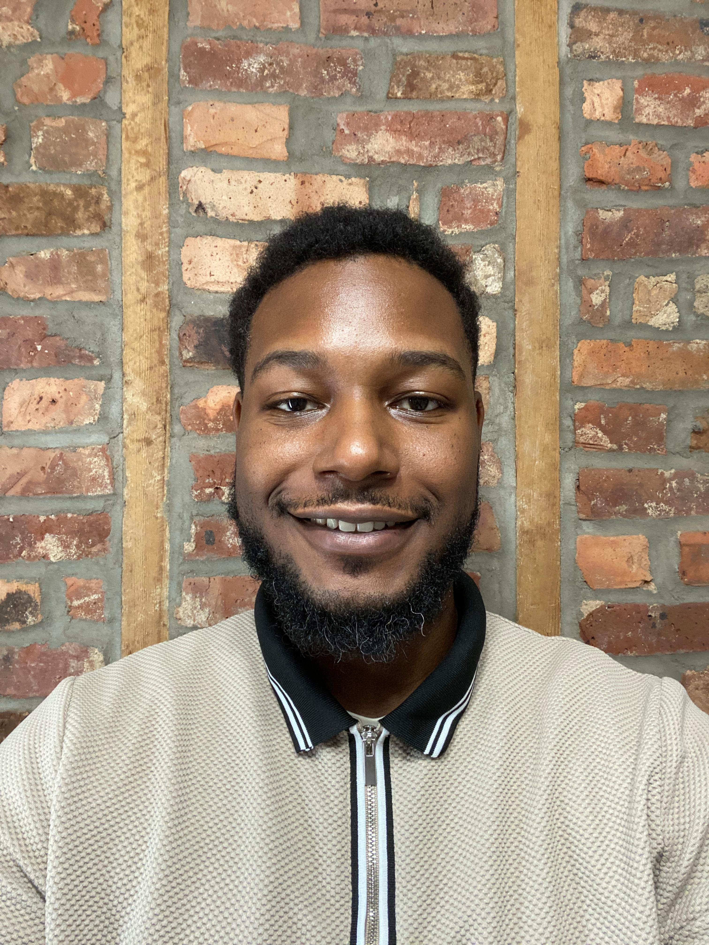
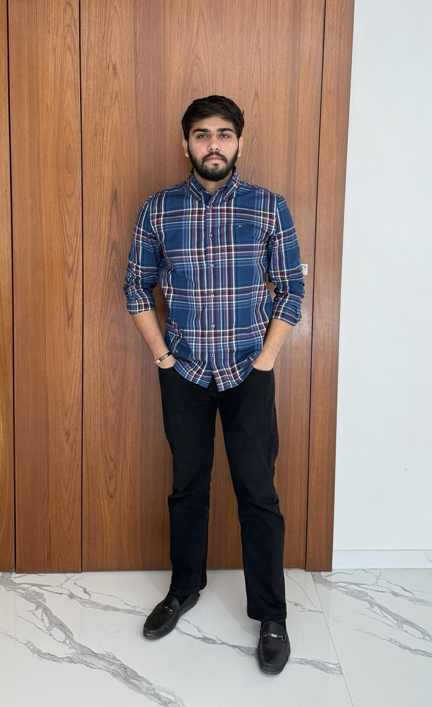
Mr Jay Patel
Role: Back-End Developer
Mr Xavier Jackon
Role: Machine Learning Lead
Mr Zenil Moradia
Role: Quality assurance

Slide 4
Problem Statement
Credit card fraud remains the leading form of identity theft in the United States, with 2024 seeing over 449,000 complaints to the Federal Trade Commission and within the first quarter of 2025 adding another 151,000 cases. In the United States, 63% of cardholders have been targeted at least once, and more than half of these victims report experiencing repeated attacks.
This persistent threat not only inflicts hundreds of millions of dollars in annual losses but also erodes consumer confidence in digital payments. Existing detection systems struggle to keep up with the evolving tactics of scammers and the extreme imbalance between legitimate and fraudulent transactions. There is an urgent need for a robust, real-time solution that can accurately flag while minimizing false alarms.

Slide 5
Problem Description
Project Name: | Machine Learning Model for Credit Card Fraud Detection
Team: | IT Architects
Project Description: | Current deterrents include rule-based fraud detection techniques, whereas our goal is to implement an AI-powered fraud-detection service that catches up to 80% of fraud attempts in real time while cutting false positives by 30%, so issuers lose less money and cardholders enjoy seamless, secure spending. This project aims to deliver an advanced machine-learning classifier for credit-card fraud detection, designed for issuers and cardholders frustrated by today’s rule-based systems and high false-alarm rates. Leveraging SMOTE to rebalance data and XGBoost for precision, we’ll identify fraudulent transactions before funds leave the account, reduce false positives on legitimate purchases, and trigger real-time alerts that let cardholders act immediately. Our mission is to replace rigid, hand-tuned rules with a data-driven model that adapts to evolving fraud patterns by minimizing losses, preserving reputations, and restoring trust in digital payments.
Benefit Outcomes: | Credit Card companies can expect a reduction in false alarms, monetary losses, and damage to their reputation. Credit Card holders can expect a reduction in unauthorized charges, fewer declined legitimate transactions, and greater peace of mind when using their cards as well as an increase in user satisfaction and engagement.
Github Link: | https://github.com/htmw/F2025-Team1/wiki

Slide 6
Persona 1: Sarah Miller
Age: 28
Occupation: Graphic Designer
Sarah is an avid online shopper who loves finding unique items from small businesses. She uses her credit card for most of her purchases, appreciating the convenience and rewards. She's tech-savvy and expects seamless digital experiences. Recently, her card details were stolen from a third-party website, leading to several unauthorized small purchases. The process of getting a new card and updating her payment information on various subscriptions was a significant hassle and made her wary of future online transactions. She's looking for reassurance and security in her digital financial interactions.
Goals:
Wants to shop online without constant worry about card fraud.
Needs quick and clear notifications for any suspicious activity on her accounts.
Hopes for an easy way to verify transactions or freeze her card directly from her phone if needed.
Frustrations:
The time and effort involved in cancelling cards and updating payment details after fraud.
Feeling vulnerable and exposed when her financial information is compromised.
Receiving generic, unhelpful alerts that don't provide clear next steps.
Needs from the Solution:
Real-time alerts that are easy to understand and act upon.
An intuitive mobile interface that allows her to quickly approve or deny a transaction and temporarily lock her card.
Minimal false positives on her legitimate purchases so she doesn't lose trust in the system.

Slide 7
Persona 2: Alex Chen
Age: 32
Occupation: Founder of "PetPals Boutique" | The E-commerce Startup Founder
Alex recently launched "PetPals Boutique," an online store selling custom pet accessories. Business is booming, but he's starting to see a disturbing trend of chargebacks due to fraudulent orders. These chargebacks not only cost him money but also damage his store's reputation with payment processors. He's passionate about his business but has limited resources and can't afford a dedicated fraud team. He needs an automated, intelligent system that can protect his revenue and allow him to focus on growing PetPals Boutique, not fighting fraud.
Goals:
To minimize chargebacks and financial losses from fraudulent transactions.
To protect his business's reputation with payment providers.
To have a simple, affordable, and effective fraud detection solution that integrates easily with his e-commerce platform.
Frustrations:
The financial impact of fraudulent orders and chargeback fees.
The time-consuming process of manually reviewing suspicious orders.
Fear that his small business could be targeted by organized fraud rings, which he feels ill-equipped to handle.
Needs from the Solution:
An easy-to-integrate API that works seamlessly with his e-commerce platform.
A dashboard that provides clear, actionable insights on potential fraud, without requiring a lot of technical expertise.
Automated decision-making that blocks high-risk transactions instantly and allows low-risk ones to proceed without delay.

Slide 8
Persona 3: Marcus Johnson
Age: 49
Occupation: Head of Fraud Prevention at "SecureBank" | The Bank Security Officer
Marcus leads the fraud prevention department at a mid-sized bank. His team handles thousands of credit card transactions daily, constantly battling sophisticated fraud schemes. With new tactics emerging all the time, his biggest challenge is staying ahead of the criminals while ensuring legitimate customer transactions are processed smoothly. He's looking for a powerful, scalable solution that can integrate with their existing systems, reduce false positives, and provide actionable intelligence to his team. He needs to improve detection rates, reduce operational costs associated with fraud investigation, and enhance customer trust.
Goals:
To significantly reduce the bank's annual losses from credit card fraud.
To decrease the rate of false positives, improving customer experience and reducing operational overhead.
To implement a system that provides real-time, adaptive fraud detection capable of learning new patterns.
Frustrations:
The constant arms race with fraudsters and the difficulty of keeping up with evolving tactics.
The pressure to maintain a high level of security without inconveniencing legitimate customers.
The sheer volume of data and the challenge of sifting through it to find genuine fraud.
Needs from the Solution:
A highly scalable system that can process millions of transactions in real time.
Advanced machine learning capabilities that can adapt to new fraud patterns and minimize false positives.
Customizable rules and thresholds that allow his team to fine-tune the system's behavior.

Slide 9
Product Prototype

Slide 10


Technology and Tools
Data Processing and Feature Engineering
Pandas / NumPy – Core tabular and numerical routines.
Dask – Scales Pandas workflows to larger‐than‐memory datasets with minimal code changes.
Imbalanced-learn – SMOTE, ADASYN, and other resampling techniques built atop scikit-learn APIs.
Model Development and Experimentation
Scikit-learn – Standardized pipeline, preprocessing, and model‐selection tools.
XGBoost / LightGBM / CatBoost – Gradient boosting implementations with GPU support for speed and advancedclass‐imbalance handling.
Optuna / Hyperopt – Efficient hyperparameter optimization via Bayesian search or Tree-structured Parzen Estimator.
MLflow – Track experiments, log parameters/metrics, and register model versions in one place.
Visualization and End-User Interface
Plotly / Dash – Interactive EDA dashboards you can hook up to live model inference.
Streamlit – Superfast prototyping of apps—forms for inputting mock transactions, real‐time results.
Tableau / Power BI – Drag-and-drop business dashboards for non-technical stakeholders, integrating CSV or databaseoutputs.

Slide 11

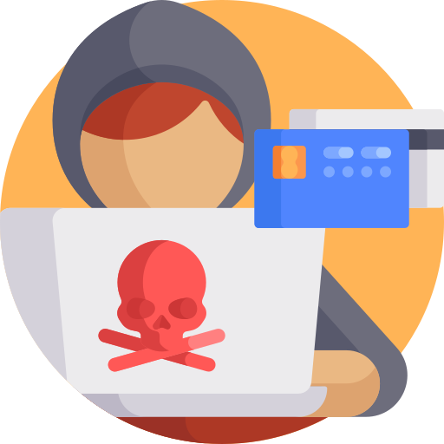
Technologies Cont.
Deployment
FastAPI – High-performance REST endpoints for batch or real-time scoring.
Docker – Containerizes entire pipeline (preprocessing → model → API) for consistency.
Kubernetes – Autoscale inference pods behind a load balancer; keeps service resilient.
Terraform – Infrastructure-as-code to spin up cloud resources reproducibly (EKS/GKE/AKS, databases, VPCs).
Collaboration
GitHub / GitLab – Version control for code, issue tracking, and CI/CD integration with Actions or Runners.
WikiPages
Data Storage & Logging
MongoDB

Slide 12
Different Models
Component | Explanation | Project Goal Alignment
The Problem (Imbalance) | If we trained a model on the raw data, it would achieve 99.83% accuracy just by guessing "legitimate" every time, making it useless for catching actual fraud. | Justifies why your model is necessary to meet the 80% fraud capture goal.
The Solution: SMOTE | We use SMOTE (Synthetic Minority Over-sampling Technique) to mathematically generate new, synthetic fraud examples that are similar to the real ones. We only do this on the training data to balance the classes and force the model to learn the fraud patterns effectively. | Addresses the severe class imbalance and improves the model's ability to achieve high Recall (catching fraud).
The Classifier: XGBoost | We use XGBoost, a powerful gradient boosting algorithm. It's excellent for tabular data and has advanced internal mechanisms (like using the scale_pos_weight parameter) to handle imbalanced datasets better than simpler models. | This choice is key to minimizing losses (high Recall) and achieving high Precision (cutting false positives).
The Output (Real-Time) | The trained model is deployed via a high-speed FastAPI service to provide predictions in milliseconds. The output is not just a score, but an Actionable Alert (e.g., "Transaction Blocked" or "Approve/Deny") displayed in the Streamlit front-end. | This satisfies the core need of your personas, especially Sarah Miller (quick alerts) and Alex Chen (real-time protection).

Slide 13
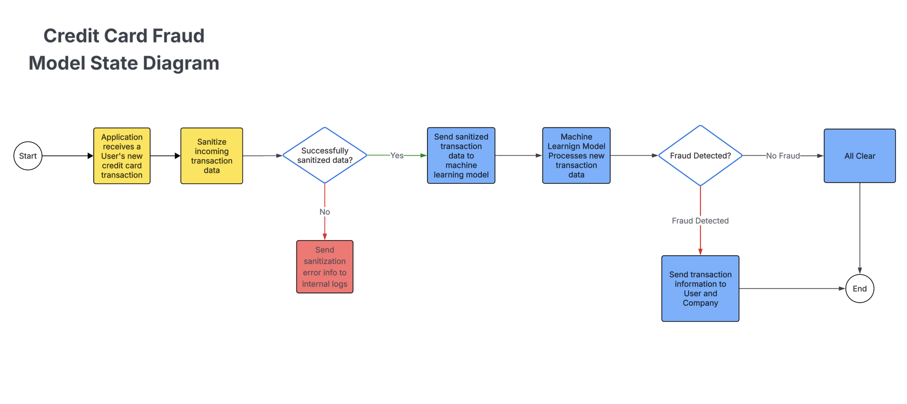

Slide 14
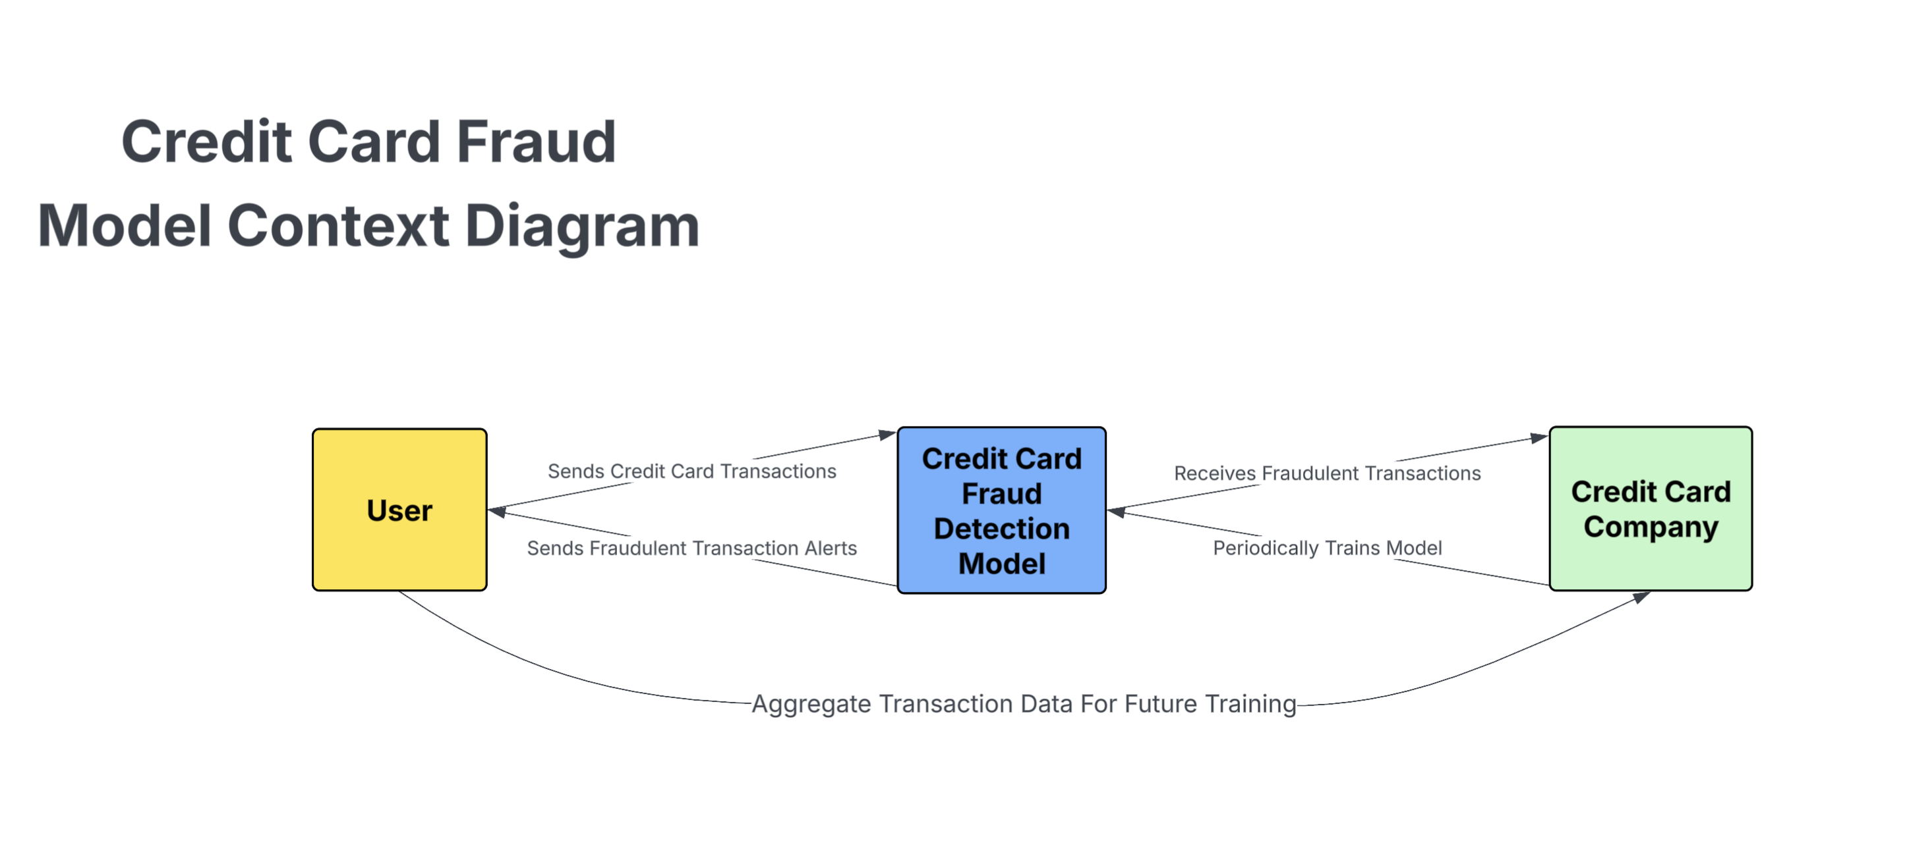

Slide 15
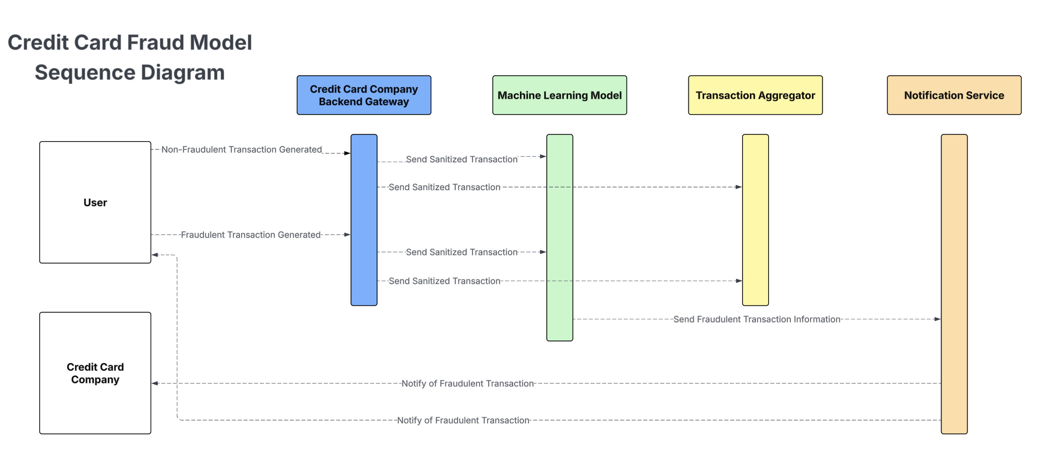

Slide 16
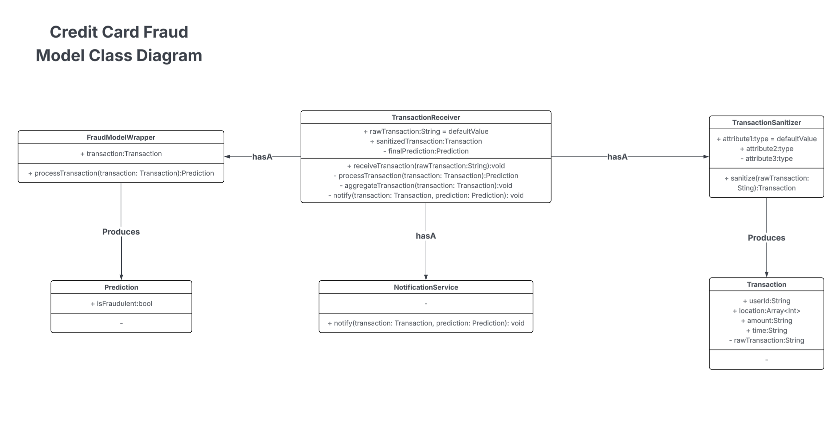

Slide 17
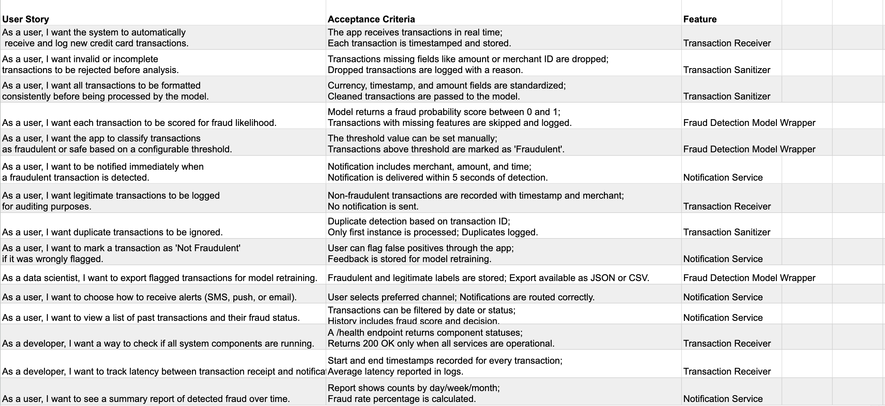
User stories

Slide 18
Sprint-1 Test Cases
Test Case ID | Scenario Description | Input Data | Expected Output | Category
TC001 | Normal low-value transaction | $50, New York, Card used before | Legit | Normal Transaction
TC002 | High-value transaction in abroad nation | $5,000,Germany, User location: USA | Fraud | Location Anomaly
TC003 | Multiple transactions in short time | 10 transactions in 4 minutes, total $5000 | Fraud | Velocity Check
TC004 | Online purchase from familiar vendors | $200, amazon | Legit | Trusted Vendor
TC005 | Transaction at unusual hour | $600, 3:00AM, Normal hours 9 AM‚9 PM | Suspicious | Time-based Anomaly

Slide 19
Sprint-1 Test Cases
TC006 | Card used after being reported lost | $500, Card status: Reported lost | Fraud | Stolen Card
TC007 | Mismatch in billing and shipping country | Billing: USA, Shipping: Australia | Fraud | Geographical Mismatch
TC008 | Multiple declines followed by approval | 3 declines, 1 approval for $900 | Fraud | Decline Pattern
TC009 | Small test transaction followed by large one | $1 then $2,000 within 5 mins | Fraud | Test Transaction Pattern
TC010 | Purchase with consistent spending history | $70, Groceries | Legit | Behavioral Match

Slide 20
Sprint-1 Test Cases
TC011 | Transaction from new device/IP | Device: Unknown, IP: new region | Suspicious | Device Anomaly
TC012 | Cross-border ATM withdrawal | Japan, User location: USA | Fraud | Geo Velocity
TC013 | Sudden change in spending category | $5000, Category: Luxury Jewelry | Suspicious | Behavioral Deviation
TC014 | Repeated identical transactions | 5 identical $500transactions in 20 mins | Fraud | Duplication Pattern
TC015 | Refund request immediately after purchase | $1500refunded after 10 mins | Suspicious | Refund Abuse

Slide 21
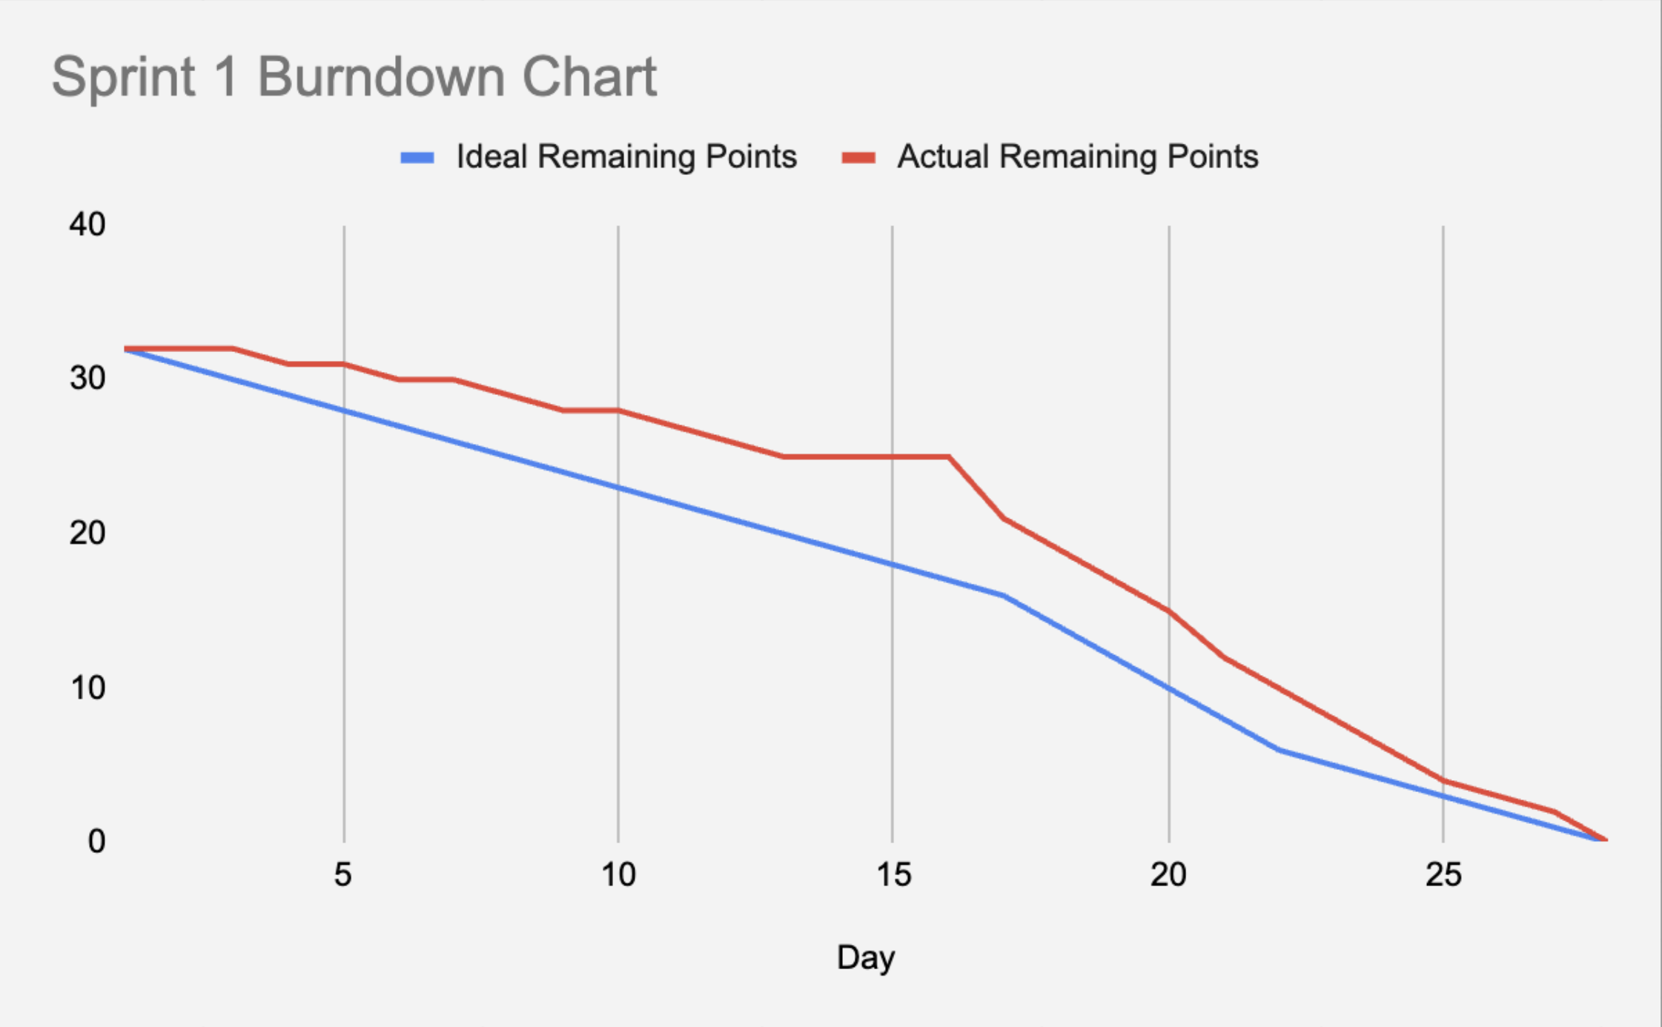

Slide 22
Sprint Retrospective
What we did well: Good sprint planning and collaboration
What we felt didn't go well: There were stretches of the sprint where we weren't able meet and had to rush more at the end of the sprint as reflected in the burndown chart
What we want to do differently next time: Daily standups were difficult because we all work and have school, want to start doing asynchronous status updates over WhatsApp

